Slide 1
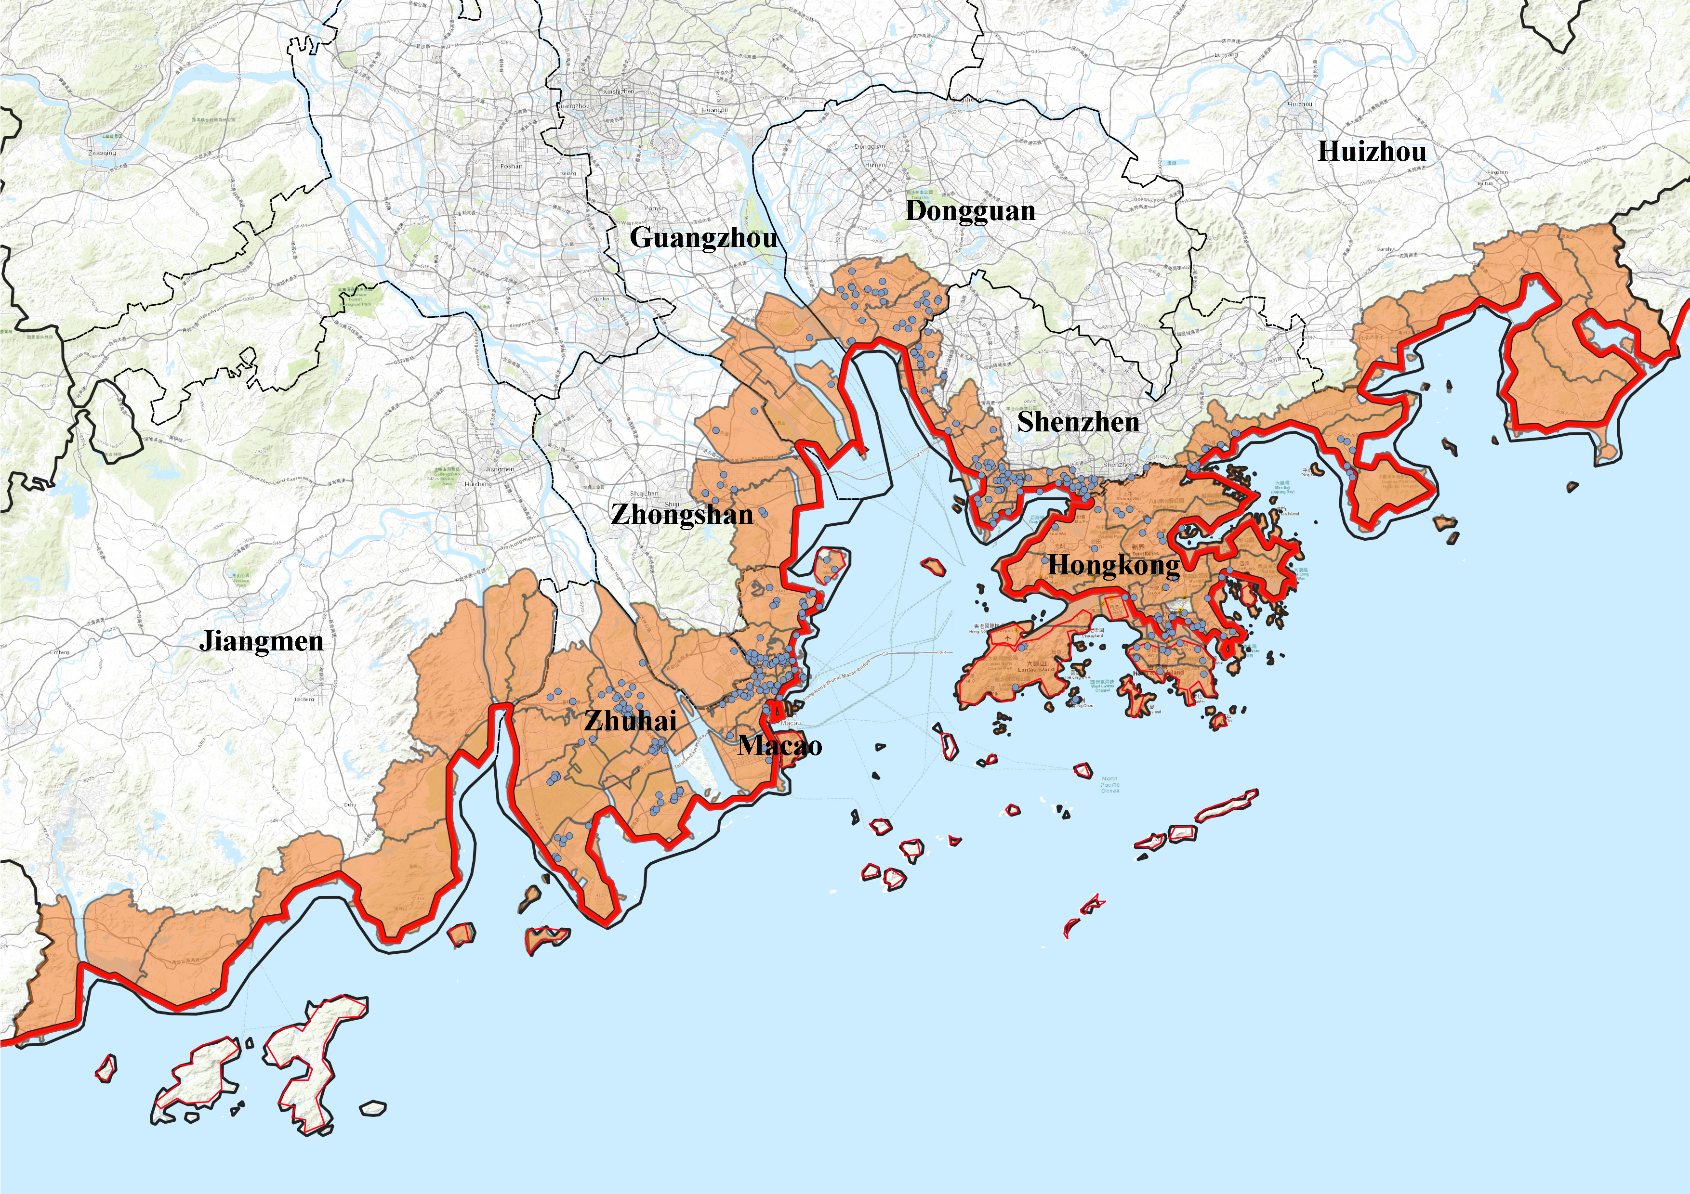
·粤港澳大湾区海岸线1公里范围内包含区域(乡镇）

Slide 2
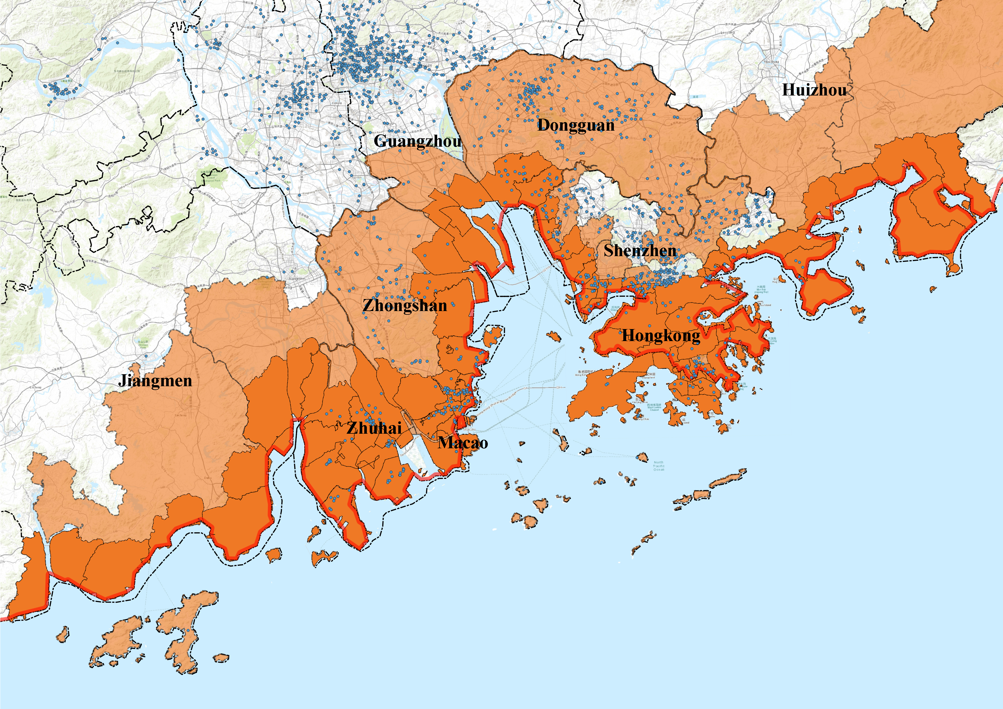
·粤港澳大湾区海岸线1公里范围内包含区域(区县）

Slide 3
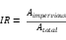
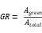
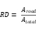
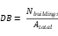
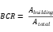
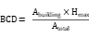
Parameter | Definition | Calculation Method | Format / Resolution | Period | Data Source
R1H (Max 1-hour rainfall) | Peak short-term rainfall intensity | Extracted from ERA5 hourly precipitation | Raster / 0.25° | 2019-2021 | ERA5 Reanalysis Dataset, ECMWF
R1DT (Daily rainfall total) | Total daily rainfall accumulation | Summation of 24-hour rainfall | Raster / 0.25° | 2019-2021 | ERA5 Reanalysis Dataset, ECMWF
IR (Impervious surface ratio) | Fraction of impermeable surface |  | Raster / 30 m | 2020 | Derived from land cover (Planning Dept. of HK) (https://www.pland.gov.hk/pland_en/text-size.html)
GR (Green space ratio) | Fraction of vegetated green areas |  | Raster / 30 m | 2020 | Derived from land cover (Planning Dept. of HK)
RD (Road density) | Proportion of road-covered area |  | Raster / 5 m | 2020 | Planning Dept. of HK
EL (Elevation) | Mean elevation above sea level | Averaged per 50 m grid | Raster / 30 m | 2020 | DEM (Planning Dept. of Hong Kong)
SL (Slope) | Terrain steepness | Gradient derived from DEM | Raster / 30 m | 2020 | Derived from elevation data
NDVI (Normalized difference vegetation index） | Vegetation index indicating greenness | Mean NDVI over each grid | Raster / 30 m | 2020 | Landsat 8; China NDVI dataset (2000–2020)
DB (Building density) | Number of buildings per unit area |  | Vector (Polyline) | 2020 | Amap
BCR (Building coverage ratio) | Building footprint per unit area |  | Vector (Polyline) | 2020 | Amap
BCD (3D building configuration density) | Volumetric building index |  | Vector (Polyline) | 2020 | Amap
Land Use | Urban land classification data | Categorical raster data | Raster / 30 m | 2023 | Planning Dept. of Hong Kong

